Slide 1

8085 -Microprocessor
Group 1 presentation

Slide 2
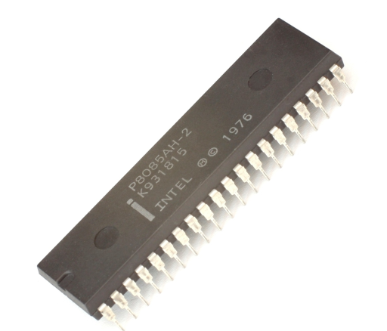
Introduction to the 8085
The 8085 is an 8-bit microprocessor designed by Intel in 1977.
It was widely used in the early days of personal computing and was a popular choice for hobbyists and enthusiasts due to its simplicity and ease of use.
The 8085 is still used today in a variety of embedded systems applications.

Slide 3
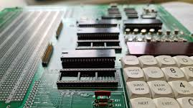
Brief history of the 8085 Microprocessor
The 8085 was a significant improvement over its predecessor, the Intel 8080.
It required less supporting hardware and was less expensive to produce.
The 8085 was also the first microprocessor to use a single +5V power supply.

Slide 4
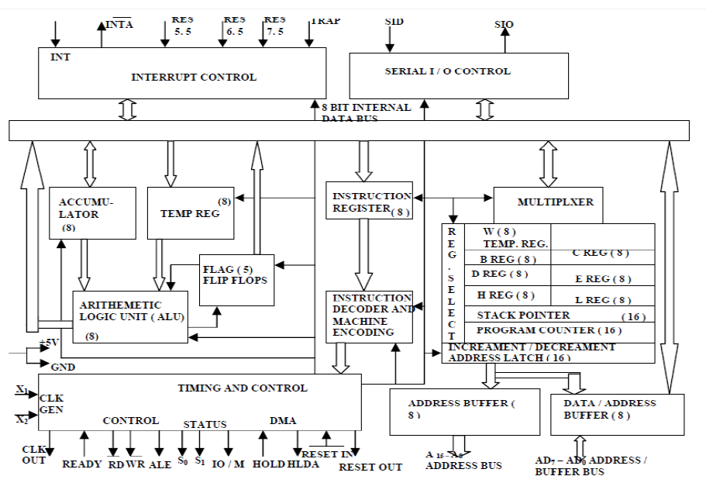
Architecture
The 8085 has a simple but effective architecture. It consists of the following major components:
Arithmetic logic unit (ALU): Performs arithmetic and logical operations on data.
Registers: Temporary storage locations for data and instructions.
Accumulator: A special register used for arithmetic and logical operations.
Flag register: Stores status information about the ALU.
Program counter: Stores the address of the next instruction to be executed.
Stack pointer: Stores the address of the top of the stack.

Slide 5
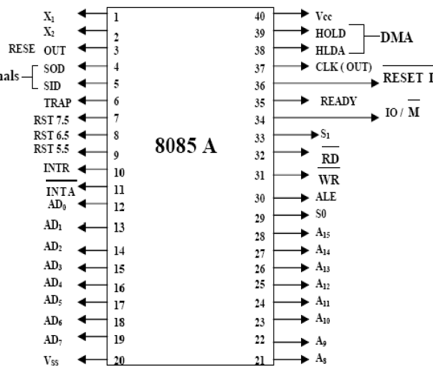
Pin Description
The 8085 has a 40-pin package logically divided into groups namely:
Address bus: 16 pins for addressing memory and I/O devices.
Data bus: 8 pins for transferring data between the microprocessor and memory or I/O devices.
Control and status signals: 11 pins for controlling the operation of the microprocessor and communicating with other devices.
Power supply and frequency signals: 3 pins for providing power and clock signals to the microprocessor.
Externally initiated signals: 2 pins for receiving interrupt signals from other devices.
Serial I/O signals: 2 pins for serial communication with other devices.

Slide 6
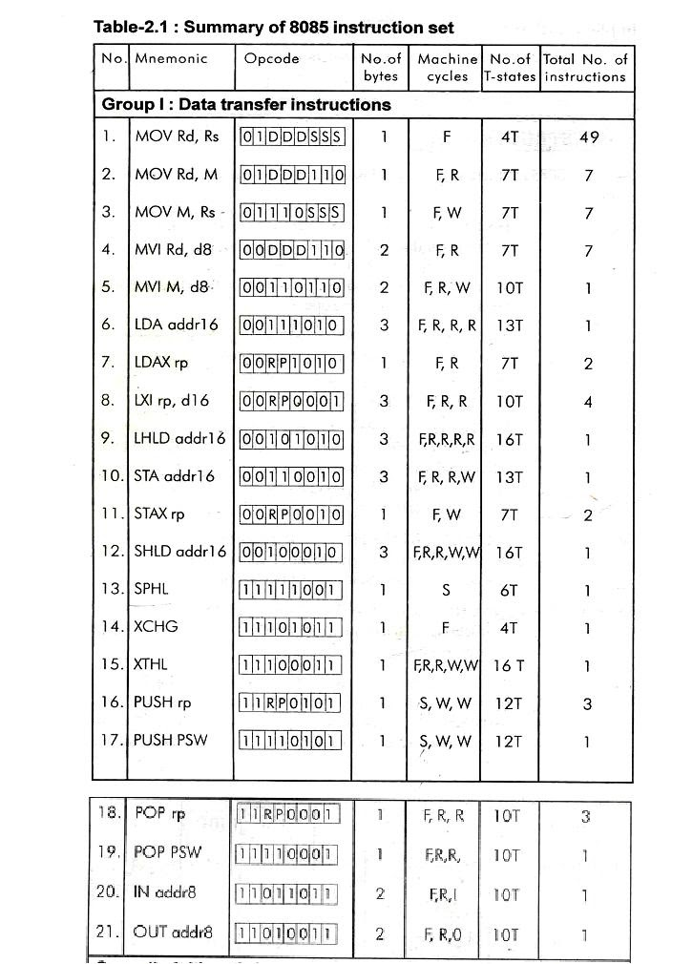
Instruction set
The 8085 has a comprehensive instruction set that includes instructions for performing a variety of tasks, such as:
Arithmetic and logical operations
Data transfer operations
Program control operations
Input/output operations

Slide 7
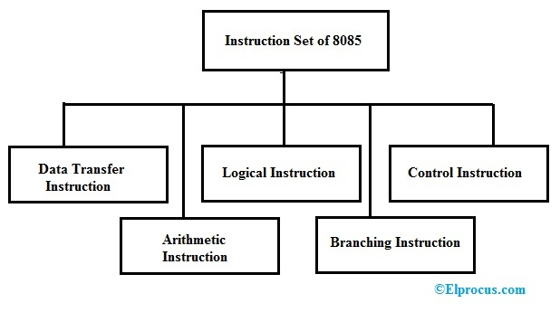
Classification of instruction set based on functionality
The 8085 instruction set can be classified into the following groups based on functionality:
Data movement instructions
Arithmetic instructions
Logical instructions
Branch instructions
Machine control operations

Slide 8
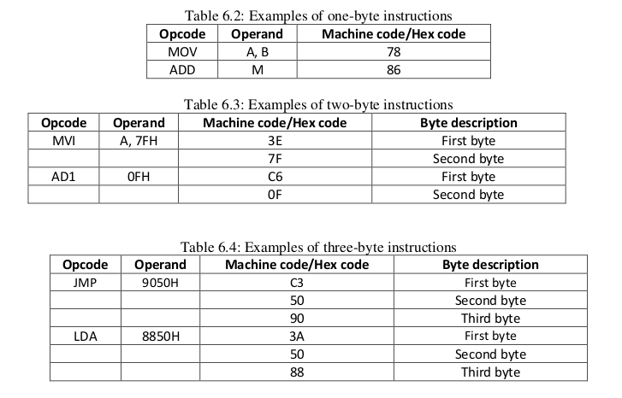
Classification of instruction set based on length
The instruction set of the 8085 processors can be further classified based on the length of the instruction:
One byte instruction
Two byte instructions
Three byte instructions

Slide 9
Addressing modes in 8085 Microprocessor
Immediate addressing: In immediate addressing, the operand is specified explicitly in the instruction. Example: MVI A, 42h (Move Immediate to Accumulator) - This instruction loads the immediate value 42h into the accumulator.
Memory direct addressing: In memory direct addressing, the operand is the content of a memory address. Example: LDA 2050h (Load Accumulator Direct) - This instruction loads the content of the memory address 2050h into the accumulator.
Register direct addressing: In register direct addressing, the operands are registers. Example: MOV A, B ; Load the value from register B into register A.

Slide 10
Addressing modes in 8085 Microprocessor
Indirect Addressing: In indirect addressing, the address of the operand is not explicitly specified in the instruction. Instead, it is stored in a register or memory location. Example MOV A, M(H) ; Load the value from the memory location pointed to by register H into accumulator A.
Implicit Addressing: In implicit addressing, the operand is implicitly specified by the instruction mnemonic. Example OUT; The contents of the accumulator are copied into the I/Oport specified by the operand.

Slide 11
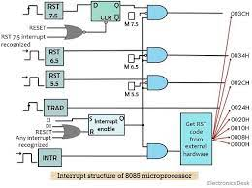
Interrupts in the 8085 Microprocessor
What are interrupts?
Signals that can temporarily suspend the normal execution of a program and redirect the control to a specific interrupt service routine (ISR).
Allowing the microprocessor to respond to external events without the need for constant polling.

Slide 12
Interrupts in the 8085 Microprocessor
8085 Interrupts can be classified based on their maskability, IVA and source:
Vectored vs. Non-Vectored Interrupts:
Vectored Interrupts: IVA (Interrupt Vector Address) is supplied by the external device, allowing flexibility in handling interrupt signals.
Non-Vectored Interrupts: Fixed IVAs for different interrupt signals, simplifying the handling process.
Maskable vs. Non-Maskable Interrupts:
Maskable Interrupts: Can be blocked through software or hardware means, providing control over interrupt handling.
Non-Maskable Interrupts: Always recognized, leading to immediate execution of corresponding Interrupt Service Routines (ISRs).
Software vs. Hardware Interrupts:
Software Interrupts: Special instructions trigger predefined ISRs upon execution, allowing software-controlled interrupt handling.
Hardware Interrupts: Signals given to the processor lead to interrupt recognition and execution of the corresponding ISR, enabling external devices to initiate interrupts.

Slide 13
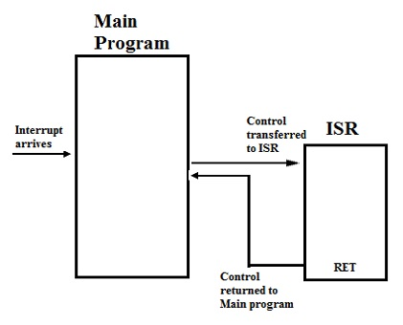
Interrupt Handling in the 8085 Microprocessor
When an interrupt signal is recognized, the processor saves its current state on the stack and jumps to the ISR.
The ISR handles the interrupt event and then executes a return instruction.
The processor restores its state from the stack and resumes executing the interrupted program.

